Slide 1
Intern Report
- Raj Kumar Karki

Slide 2
Part 1
Introduction to Organization

Slide 3
Part 1 Introduction to Organization
1. Organization Details
2. Organization Hierarchy

Slide 4
Part 1 Introduction to Organization
The Institute for Study and Development Worldwide (IFSD) is a research and consulting organization based in Sydney, Australia.
It is an international research and development organization that provides expert advice to governments, international agencies, universities, community groups, and the private sector, aiming to foster resilient and inclusive development across Asia, the Pacific, and Africa.
1. Organization Details

Slide 5
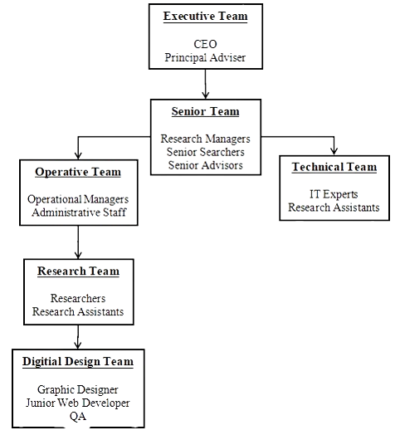
Part 1 Introduction to Organization
2. Organization
Hierarchy

Slide 6
Part 2
Internship Activities

Slide 7
Part 2 Internship Activities
1. Roles and Responsibilities
2. Technical Details of Activities
3. Project Involved During Internship
4. Tasks / Activities Performed

Slide 8
Part 2 Internship Activities
1. Roles and Responsibilities
My main roles was to help create and maintain IFSD websites
Under the guidance of the technical and IT teams

Slide 9
Part 2 Internship Activities
Main tasks involved customizing WordPress themes to match the organization's branding and functional requirements.
This included making design adjustments and optimizing site performance with plugins for better SEO.
I designed graphics, infographics, and features image for blogs and website posts using Canva, ensuring they aligned with our brand's look and feel.
2. Project Involved During Internship

Slide 10
Part 2 Internship Activities
creating web pages, adding content, and formatting text and images according to design guidelines provided by senior developers.
customize WordPress themes by implementing design changes to match IFSD requirements.
installing and configuring plugins
ensure proper functionality across different browsers and devices.
3. Tasks / Activities Performed

Slide 11
Part 2 Internship Activities
ensure proper functionality across different browsers and devices.
debugged issues like broken links, formatting errors, and plugin conflicts.
participated in team meetings, contributing ideas and solution.
note down the tasks I worked on, including changes made to websites and even the issues came in website.
solved the issues of website page and devices responsible not working.
3. Tasks / Activities Performed

Slide 12
Internship Description Table
Organization Name: | IFSD
Start date: | 5thAugust, 2023
End date: | 10thMarch, 2024
Total duration: | 6 Months
Intern position: | Junior Web Developer
Office Hour: | 2 hours per day
Location: | Remotely

Slide 13
Thank you for Listening

